Slide 1
University of Computer Studies, Mandalay
Title : Recommender system based on user-based collaborative filtering
Supervisor : Daw Tin Myo Latt Presenter : Mg Soe Moe Aung Roll No : 5CS-72 Seminar : Second Seminar Date : 5.6.2015

Slide 2
Outline
Abstract
Introduction
Objectives
Recommender System
Collaborative Filtering (CF)
User-based CF
Overview of the system
Conclusion
References

Slide 3
Abstract
The widespread use of the Internet to extract information
needed.
The continuous growing amount of information and variety
of items leads to the essential tool to filter information and
for finding useful items.
The use of Recommender Systems (RSs), software tools and
techniques providing suggestions for items and information
to user.

Slide 4
Abstract (Cont’d)
All the methods used in giving recommendation, collaborative filtering(CF) systems use to describe recommended items depend on user’s past behavior.
This system classifies and suggests movies by using user-based collaborative filtering.
This system applies the method of Pearson Correlation Coefficient(PCC) for similarity among users and the Weighted Sum method for prediction value.

Slide 5
Introduction
The world became an information world and the broad access
of the internet.
Everyday more and more information is uploaded to the
internet and it's getting harder to find the most relevant items
in the internet.
People need help to find the reliable information and to extract
the information.

Slide 6
Introduction (cont’d)
Recommender systems are tools which are used to help
people for finding suitable product or services (such as
books, movies, music, web sites, etc).
User-based collaborative filtering are used rely on the
user’s past rating history to generate recommendations
movies.

Slide 7
Objectives
To build movie rating prediction models with a simple
representation, based on previous ratings.
To help users by making movies recommendations that are
likely to be of interest to the user.
To receive information of previous user with their
preferences rating.
To provide the relevant movies for the user
To save time and effort in searching the movies

Slide 8
Recommender System
Recommender systems (RS) are information processing systems which gather different kinds of data to perform suggestion.
The main techniques used to generate recommendations are collaborative filtering (CF), content based filtering, hybrid filtering, demographic, knowledge-based and community –based.

Slide 9
Recommender System (Cont’d)
Among these systems, collaborative filtering is the most popular and widely implemented technique in RS.
CF: recommends to the active user the items that other users with similar tastes liked in the past.

Slide 10
Collaborative Filtering (CF)
Collaborative filtering systems produce predictions or recommendations for an active user based on the opinions of other users, one or more items.
Items consist of anything (such as books, CDs, movies etc.) for which people can rate it.
Collaborative filtering has various forms of ratings.
- Numerical Ratings (Such as; 1-5 stars and 1-10 scale)
- Ordinal Ratings (Such as; "strongly agree, agree, neutral, disagree, strongly
disagree")
- Binary Ratings (Such as; "good, bad" and "like, dislike")
- Unary Ratings (Defines if the user has observed/purchased the item or not)

Slide 11
Collaborative Filtering (Cont’d)
CF recommender systems can be classified into memory-based and model-based collaborative filtering.
Memory-based CF: predict the missing ratings based on similarity between users or items, which require all ratings, items and users must be stored in memory.
Memory-based CF has two approaches which are user-based and item-based CF.
User-based CF is a well known approaches of memory-based CF.

Slide 12
User-based CF
User-based CF algorithms calculate the user similarity for recommendation based on user-item ratings matrix.
In a user-based CF, the recommender rank users based on the similarity among them and uses suggestions provided by most similar users to recommend new items.
User-based CF have a list of n items I= {i₁, i₂, i₃, ……i_{n}} and a list of k users U= {u₁, u₂, u₃, ….., u_{k}}.

Slide 13
User-based CF (Cont’d)
The most important step in the user-based CF is the searching of the target user’s neighbor.
There are three main methods to compute similarity between users: cosine similarity, Pearson correlation coefficient (PCC) similarity and the modified cosine similarity.
Among them, PCC can represent the similarity of users or items better than that of other methods.
If the most similar users are found, the prediction is then computed by taking a weighted average of the active user’s ratings.

Slide 14
Pearson Correlation Coefficient (PCC)
Pearson’s correlation coefficients are used to determine the degree of correlation between an active users and another user.
PCC is denoted by r
1 < r < -1
- positive value : positive linear correlation;
- negative value: negative linear correlation;
- value of 0 : no linear correlation;
- the closer value of 1 or -1 : stronger the linear correlation

Slide 15
Pearson Correlation Coefficient (Cont’d)
PCC describe the strength of correlation for the absolute value of r.
1 < r < -1 correlation
0.00 - 0.19 “very weak”
0.20 - 0.39 “weak”
0.40 - 0.59 “moderate”
0.60 - 0.79 “strong”
0.80 - 1.0 “very strong”

Slide 16
Weighted Sum
This method computes the prediction on an item for an active user by computing the sum of the ratings given by the user on the items.
Each ratings is weighted by the corresponding similarity between active user and the previous users.

Slide 17
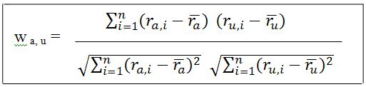
User-based CF
Step 1:
Similarity between the active user and previous user is calculated by using PCC.

Slide 18
Where :
a : active user
u: previous users
n: the number of the items that both the active user and all
recommender users have rated
ra , ru: the average ratings of the active user a and previous user u.
Wa,u : the degree of correlation between active user a and previous user
u.

Slide 19
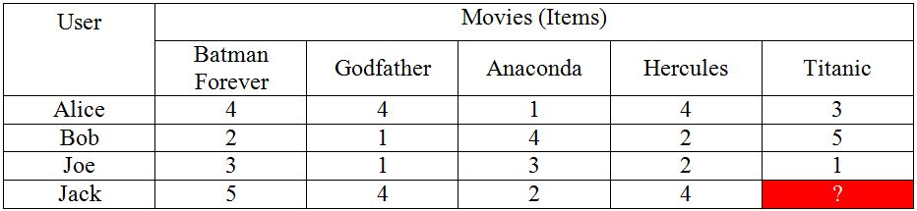
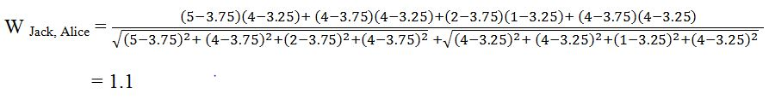
Example for step 1
User-based CF have a list of items {Batman Forever, Godfather,
Anaconda, Hercules , Titanic} and a list of users {Alice, Bob, Joe, Jack}
In this example, Jack is the active user and Alice, Bob and Joe are the previous users.

Slide 20
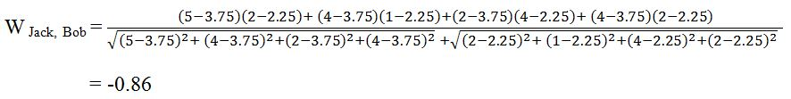
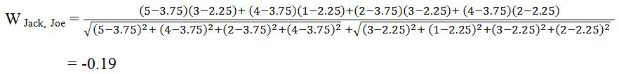

Slide 21
Step 2:
Based on the similarity value with active user and a set of previous users, most similar are select for active user.
Example for step 2
In this step, Jack is similar to Alice because the value of PCC method becomes 1.1 .
Other values are negative so the pairs of user are not similar.

Slide 22
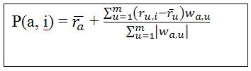
Step 3:
To compute the prediction for an item i for active user a, a weighted sum formula is used.
Where :
m : total number of users
ra , ru : the average rating of the active user a and previous user u
u : previous users
Wa,u : the degree of correlation between active user a and previous
user u
P(a,i) : prediction of active user a on item i

Slide 23
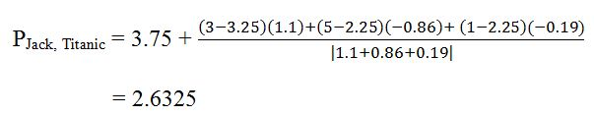
Example for step 3
The prediction for active user Jack on item Titanic denoted by P (Jack, Titanic).

Slide 24
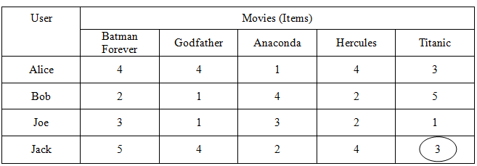
Prediction Result

Slide 25
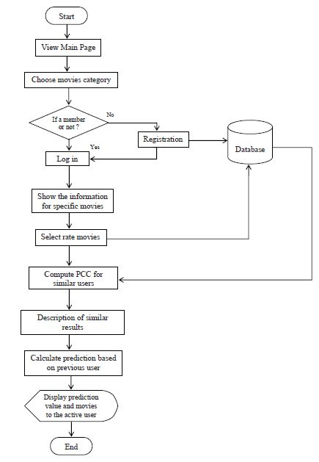
Overview of the System
Fig. System Flow Diagram

Slide 26
Conclusion
The important goals of user-based recommender systems is
to recommend accurate information to the users.
This systems benefit users by enabling them to find they like.
The user can view the detail information and rating items.
This system can provide the efficient recommended list for
the specific items and the user can decide which items are
the best to suggest.

Slide 27
Conclusion (Cont’d)
This system can effectively apply the rating in computing similarity for improving the prediction.
Pearson correlation coefficient can be computed similarity among users and then weighted sum are used for prediction.
The method of PCC is simple and easy to implement.

Slide 28
References
Priyanka Shenoy1, Manoj Jain1, Abhishek Shetty1, Deepali Vora2 “ Web Usage Mining Using Pearson’s Correlation Coefficient” Vol. 3, Issue 2, March -April 2013, pp.676-679 .
Sanjog Ray, Anuj Sharma “A Collaborative Filtering Based Approach for Recommending Elective Courses”
TUĞÇE ÖZBERK YENER “ USER PREFERENCE BOOSTED CONTENT-BASED RECOMMENDER SYSTEM” MAY 2013

Slide 29
Thank You

